Slide 1

Energy states of an electron in a box
Sep 5, 2017
Jeonghyun Ko
Department of Chemical and Biomolecular Engineering
University of Notre Dame

Slide 2
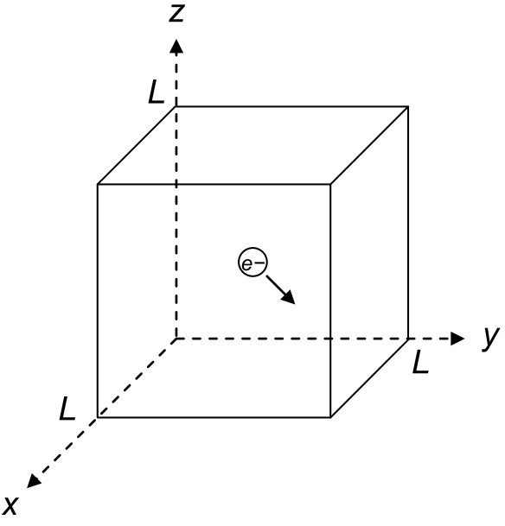
Particle in a Box
Schrodinger equation

Slide 3
Particle in a Box
Separation of variables
1-D particle in a box
V(x)
0
L
x

Slide 4
Particle in a Box
1-D particle in a box
General solution
Boundary conditions

Slide 5
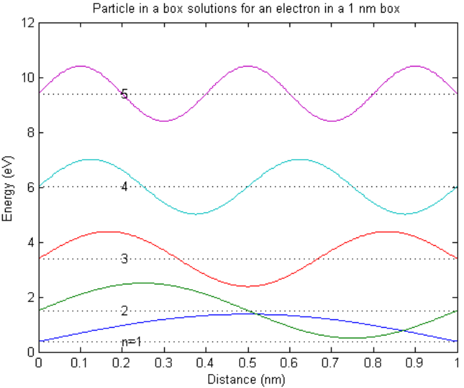
Particle in a Box
Normalization
cf)

Slide 6
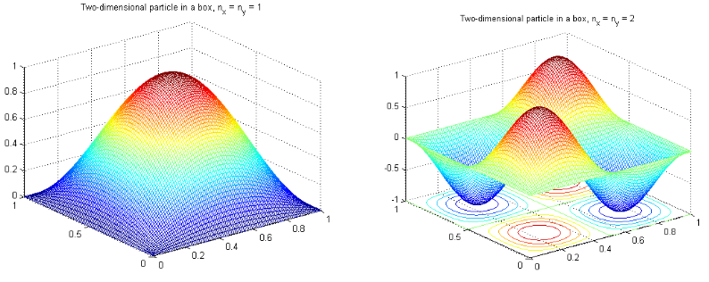
Particle in a Box
3-D particle in a box

Slide 7
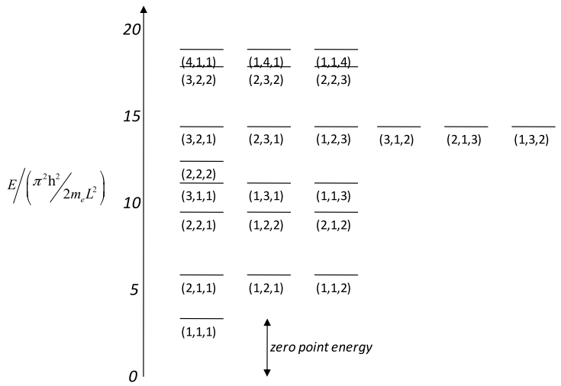
Particle in a Box

